Slide 1
F20DL Data Mining and Machine Learning
Diana Bental
(with material from David Corne and slides from http://www.cs.waikato.ac.nz/ml/weka/book.html)

Slide 2
Lecture 5 Output: Knowledge Representations
We’ve talked about inputs
Concepts, instances, attributes
And some practical issues in preparing inputs
Normalisation
Discretizatiopn (binning)
Missing values
Data inspection
Now we look at outputs
Knowledge representation

Slide 3
Output: Knowledge Representation
We have met some knowledge representations, e.g.
Lecture 2 (and Lab 1)
Structural – we can look at the model
Tables, rules, decision trees
Lecture 4
Instance-based – the examples are the model
1-nearest-neighbour

Slide 4
Output: Knowledge Representation
Different learning methods produce different knowledge representations
The knowledge representation determines what we can do with the model – how we can reason or compute with it

Slide 5
Tables
Very simple, readable
Same format as the input!
Main issue: How to select the most relevant attributes?
E.g. Decision Table for the Weather problem – ignore temperature because it (usually) makes no difference
Outlook
Humidity
Play
Sunny
High
No
Sunny
Normal
Yes
Overcast
High
Yes
Overcast
Normal
Yes
Rainy
High
No
Rainy
Normal
No
Notes:
Look up whether to play or not
Numeric attributes – regression table

Slide 6
Linear Models
Simple
Regression – attributes are all numeric (including the one we want to predict)
Output is a sum of weighted attribute values
Main issue: How to find good values for the weights?
Linear models for prediction and classification

Slide 7
Linear Regression
Input: 209 different computer configurations
Model: a linear regression function to predict performance
Cycle time (ns)
Main memory (Kb)
Cache (Kb)
Channels
Performance
MYCT
MMIN
MMAX
CACH
CHMIN
CHMAX
PRP
1
125
256
6000
256
16
128
198
2
29
8000
32000
32
8
32
269
…
208
480
512
8000
32
0
0
67
209
480
1000
4000
0
0
0
45
PRP = -55.9 + 0.0489 MYCT + 0.0153 MMIN + 0.0056 MMAX + 0.6410 CACH - 0.2700 CHMIN + 1.480 CHMAX
Notes:
Get a series of weights 0.0489 , 0.0153 etc and a bias term -55.9
Note that attributes are just weighted and added up. No squaring or cubing or dividing by each other. This is what makes it LINEAR.

Slide 8
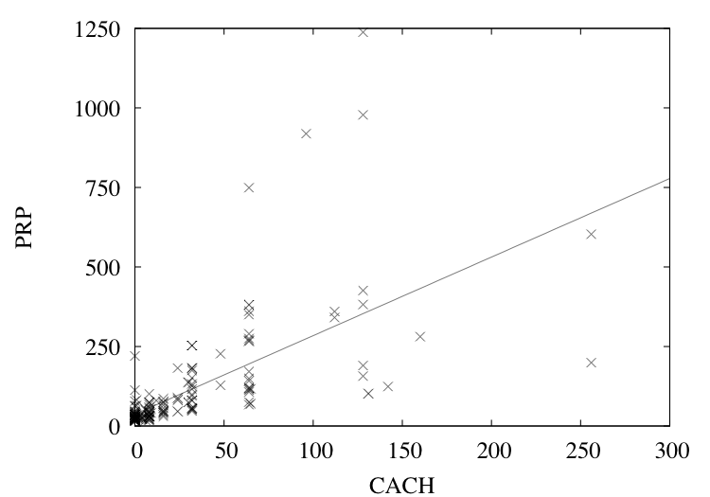
Visualise one variable (Cache) and its effect on performance (PRP)
Notes:
Just one variable CACHE weight 2.47
And a bias term 37.05
Straight line function
Easy to visualise as a 2d Graph drawing a straight line through the points
Input a value for CACHE, compute a value for performance

Slide 9
Linear models for (binary) classification
Binary classification
Line separates the two classes
Decision boundary - defines where the decision changes from one class value to the other
Prediction is made by plugging in observed values of the attributes into the expression
Predict one class if output >= 0, and the other class if output < 0
Boundary becomes a high-dimensional plane (hyperplane) when there are multiple attributes
Notes:
2 attributes + class -> line
3 attributes + class -> plane
More attributes - > hyperplane

Slide 10

Classifying iris flowers – using rules
Sepal length
Sepal width
Petal length
Petal width
Type
1
5.1
3.5
1.4
0.2
Iris setosa
2
4.9
3.0
1.4
0.2
Iris setosa
…
51
7.0
3.2
4.7
1.4
Iris versicolor
52
6.4
3.2
4.5
1.5
Iris versicolor
…
101
6.3
3.3
6.0
2.5
Iris virginica
102
5.8
2.7
5.1
1.9
Iris virginica
…
If petal length < 2.45 then Iris setosa
If sepal width < 2.10 then Iris versicolor
...
Notes:
Table plus rules

Slide 11
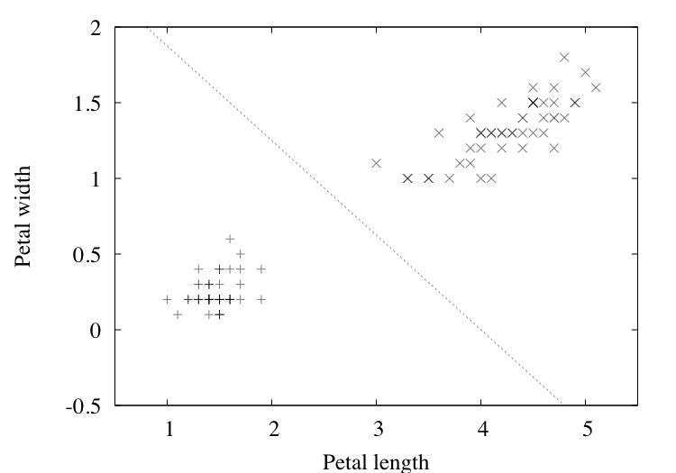
Separating setosas from versicolors – using a regression equation
2.0 – 0.5PETAL-LENGTH – 0.8PETAL-WIDTH = 0
Notes:
Different methods for deciding where the line is, i.e what the weights are; least squares linear regression (this slide) or perceptron training (CPU performance)
Setosas on one side, versicolors on the other
Hyperplane to look at more attributes (sepal length and width) and classify the 3rd group (virginicas)
NB no sgnificance to shading. + = setosa, X = versicolor

Slide 12
Decision Trees
Top down “divide and conquer” approach produces a tree
Each node tests a particular attribute
Usually compare the attribute value to a constant
One branch per (categorical) value
Or Compare two attributes
Or Use a function of the attribute(s)
To classify a new instance:
Travel down the tree, testing each attribute
Classification at a leaf
Classification(s) or probability distribution

Slide 13
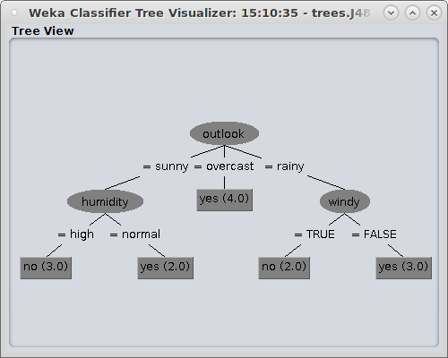
Decision tree example – weather data
outlook = sunny, temperature= cool, humidity = high, windy = true, play = ?
Notes:
Step through outlook=sunny, humidity = high, play = no
Temperature and windy are ignored in this case. They don’t make a difference to the outcome.
Different attributes in different parts of the tree.
Though windy makes a difference if the outlook is rainy.

Slide 14
Trees for Nominal and Numeric Attributes
Nominal (categorical) attributes
One child per value
So each attribute only gets tested once
Numeric attributes
Greater / less than / equal to a constant (3 children)
Test for an interval or range (within/ above / below)
One attribute may be tested several times, to compare with different values or ranges

Slide 15
Trees – what about missing values?
If the absence of a value has a known meaning then need an explicit special value and test for it
If not then need a process
Follow the branch with most instances in the training set
Or assign a weight to all possible leaves, depending how many training instances go to each leaf
Notes:
Most instances = most popular branch
Or use weights to decide an average; or compute sum of weights if values repeat at different leaves

Slide 16
Using Trees for Numeric Prediction
Motivation
Recall the linear regression equation for the CPU data…..
PRP = -56.1 +0.049 x MYCT + 0.015 x MMIN + 0.006 x MMAX + 0.630 x CACH -0.270 x CHMIN + 1.46 x CHMAX
But equation is not very accurate
Regression tree: a “decision tree” where each leaf predicts a numeric quantity
The predicted value is the average value of the training instances that reach the leaf

Slide 17
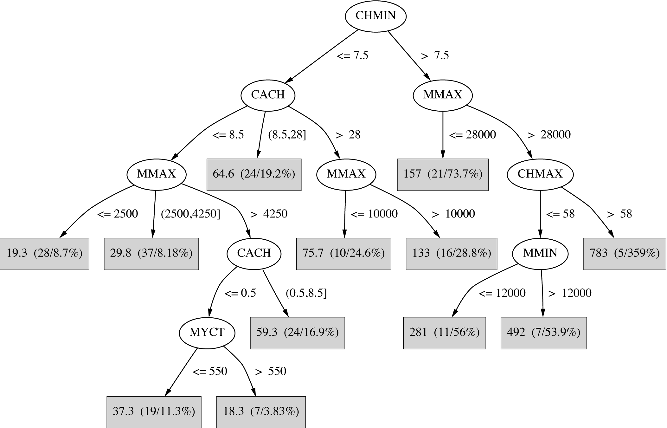
Regression tree for the CPU data
Notes:
Each leaf represents an average outcome for instances that reach the leaf
The tree is bigger than the equation and more complex and harder to understand
But it’s more accurate – smaller error between predicted and actual performance values because simple linear equation isn’t all that accurate
First number is the value: in parens there is the error for the tree / linear regression, for comparison

Slide 18
Using Trees for Numeric Prediction
Model tree: a “decision tree” with linear regression models at the leaf nodes
Linear patches that approximate the continuous function

Slide 19
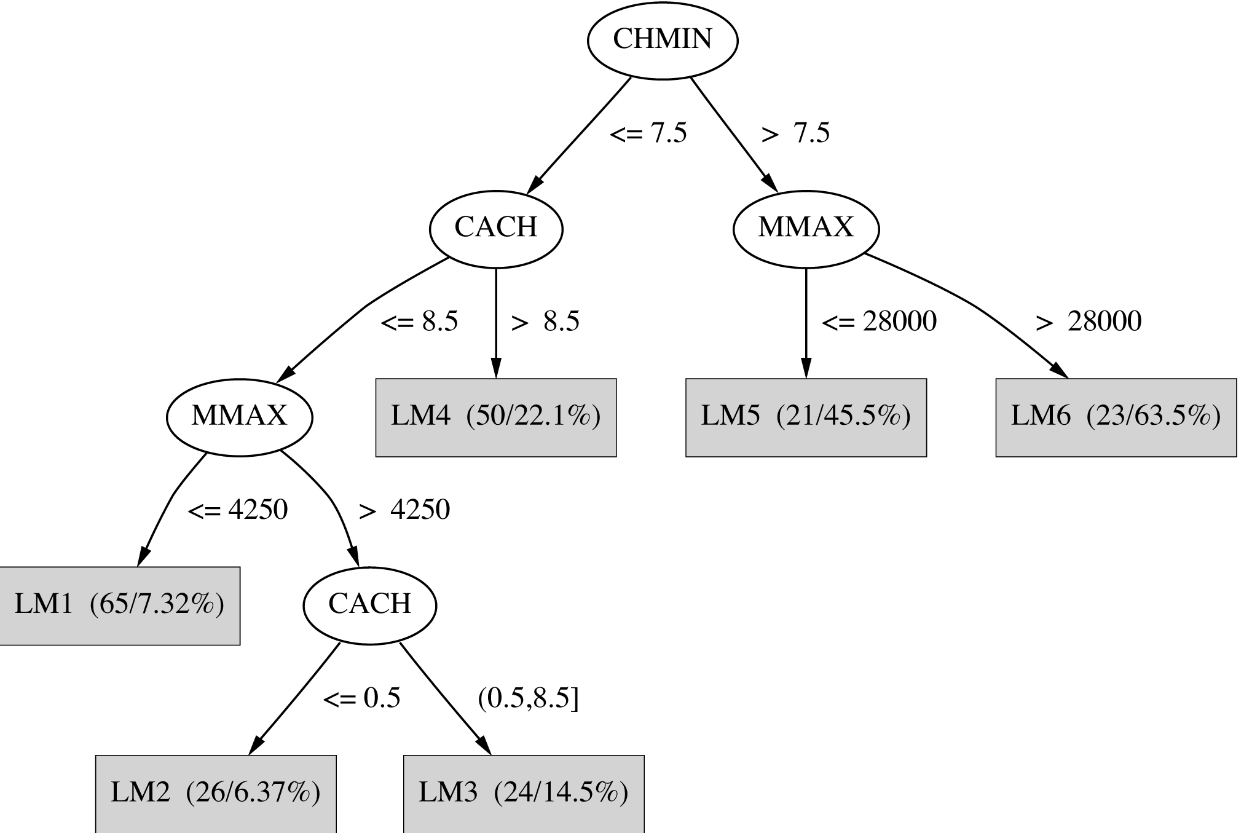
Model tree for the CPU data
LM1 PRP = 8.29 + 0.004 x MMAX +2.77 x CHMIN
LM3 PRP = 38.1 + 0.0012 x MMIN
etc
Notes:
Mix’n’match a decision tree with (simpler) linear regression equations
LM1 to LM6 are six different linear equations (models) – one for each leaf
Smaller and simpler than the regression tree and also better errors on the training data than the regression tree – but measuring on the training data isn’t reliable… might be overfitting

Slide 20
Classification rules
Popular alternative to decision trees
Antecedent (pre-condition): a series of tests (just like the tests at the nodes of a decision tree)
Tests are usually logically ANDed together (but may also be general logical expressions)
Consequent (conclusion): classes, set of classes, or probability distribution assigned by rule
Individual rules are often logically ORed together
Conflicts arise if different conclusions apply
Notes:
If petal-length < 2.45 AND sepal-length > 3.0 - antecedent
Then iris-setosa – consequent

Slide 21
From trees to rules
Easy: converting a tree into a set of rules
One rule for each leaf:
Antecedent contains a condition for every node on the path from the root to the leaf
Consequent is class assigned by the leaf
Produces rules that are unambiguous
Doesn’t matter in which order they are executed
But: resulting rules are unnecessarily complex
Pruning to remove redundant tests/rules
Notes:
Start at the root
New rule at each branch
Until you get to the leaf
Refer to regression tree example slide

Slide 22
From rules to trees
More difficult: transforming a rule set into a tree
Tree cannot easily express disjunction between rules
Example: rules which test different attributes
Symmetry needs to be broken
Corresponding tree contains identical subtrees (“replicated subtree problem”)
If a and b then x
If c and d then x

Slide 23
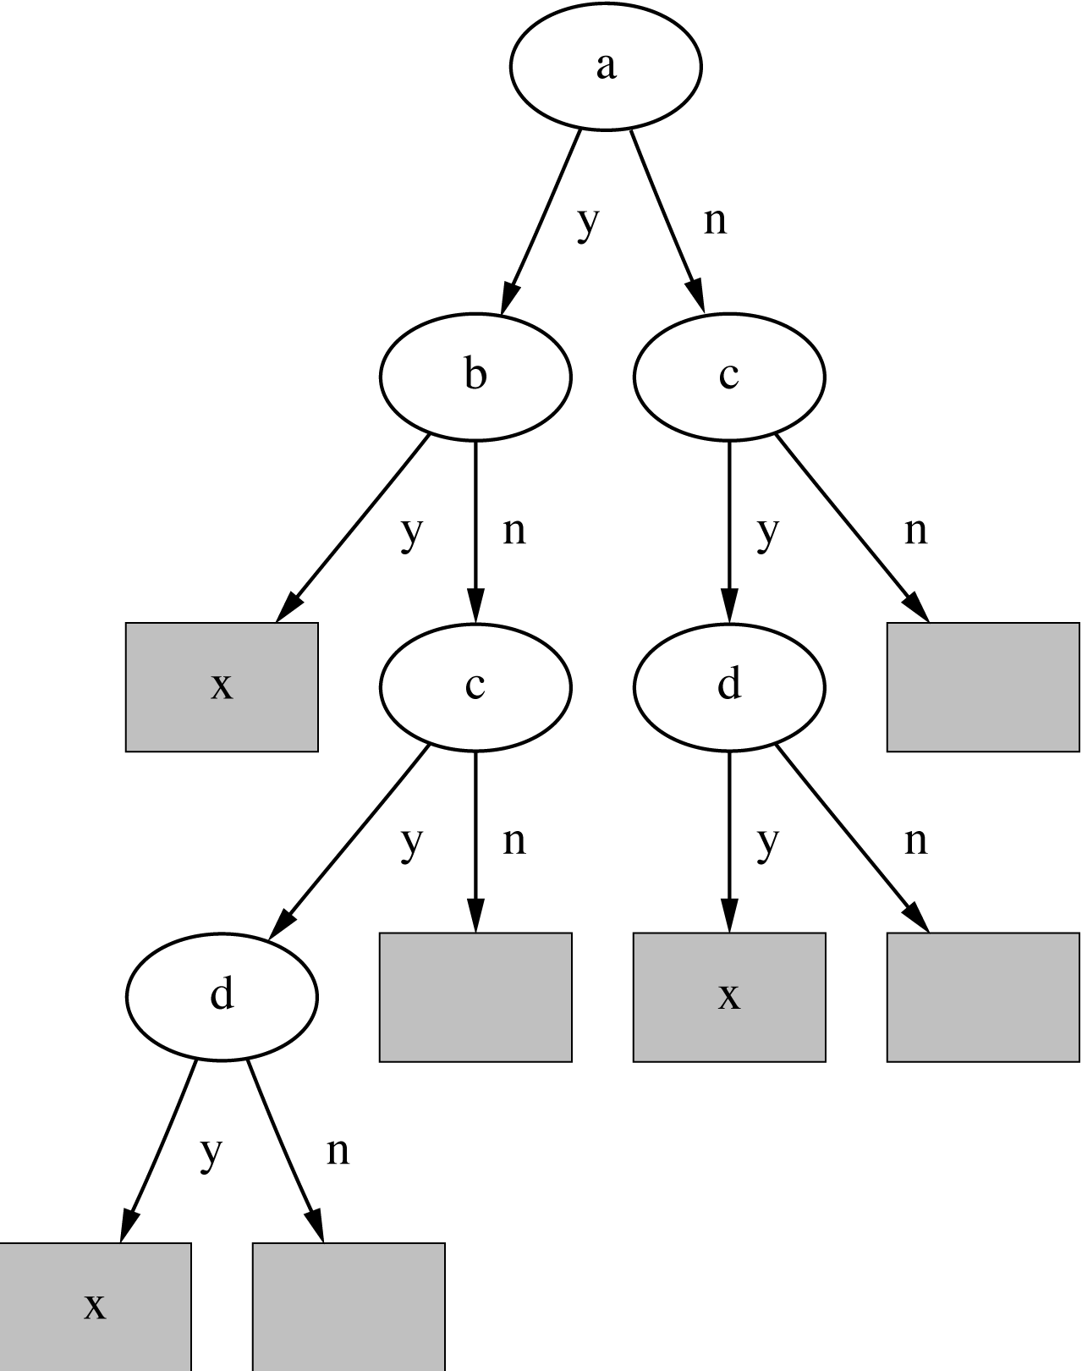
A complex tree for a simple disjunction
Rules
Tree
If a and b then x
If c and d then x
Notes:
The tree for if a and b then x ; if c and d then x
Simple rules, complicated tree
Replicates the subtree for c and d
Either have to split on a or c; if split on a then have to repeat the c /d subtree under not-a and not-b
If you took the tree and read rules from it you’d have something equivalent but more complicated and not symmetrical
If a and b then x
If a and not-b and c and d then x
If not-a and c and d then x

Slide 24
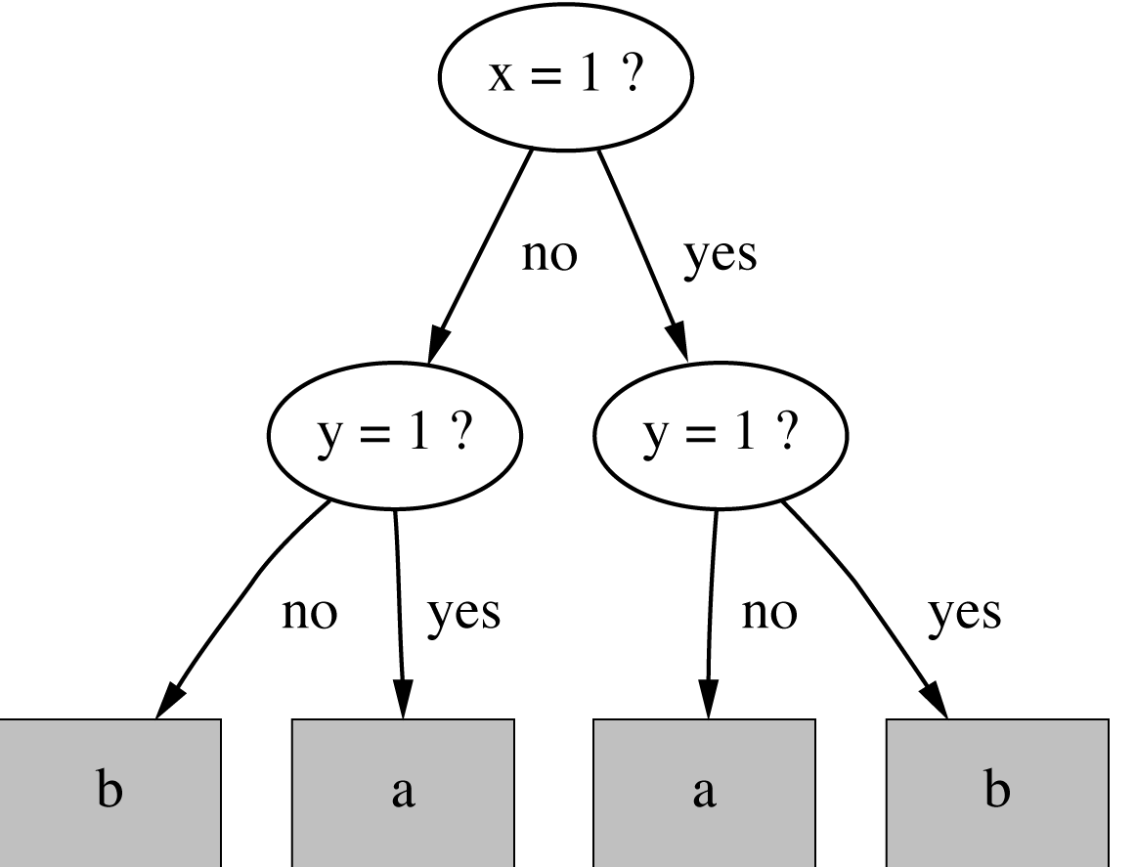
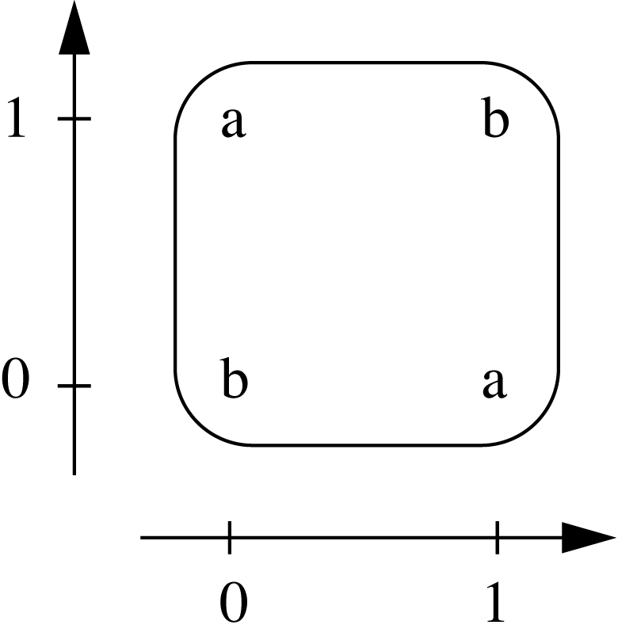
The exclusive-or problem
If x = 1 and y = 0 then class = a
If x = 0 and y = 1 then class = a
If x = 0 and y = 0 then class = b
If x = 1 and y = 1 then class = b
Notes:
x=1 or y=1 but not both
Simple tree but the x/y symmetry is not shown in the tree
Rules are the same as you’d get by reading off the tree – but symmetry is clearer

Slide 25
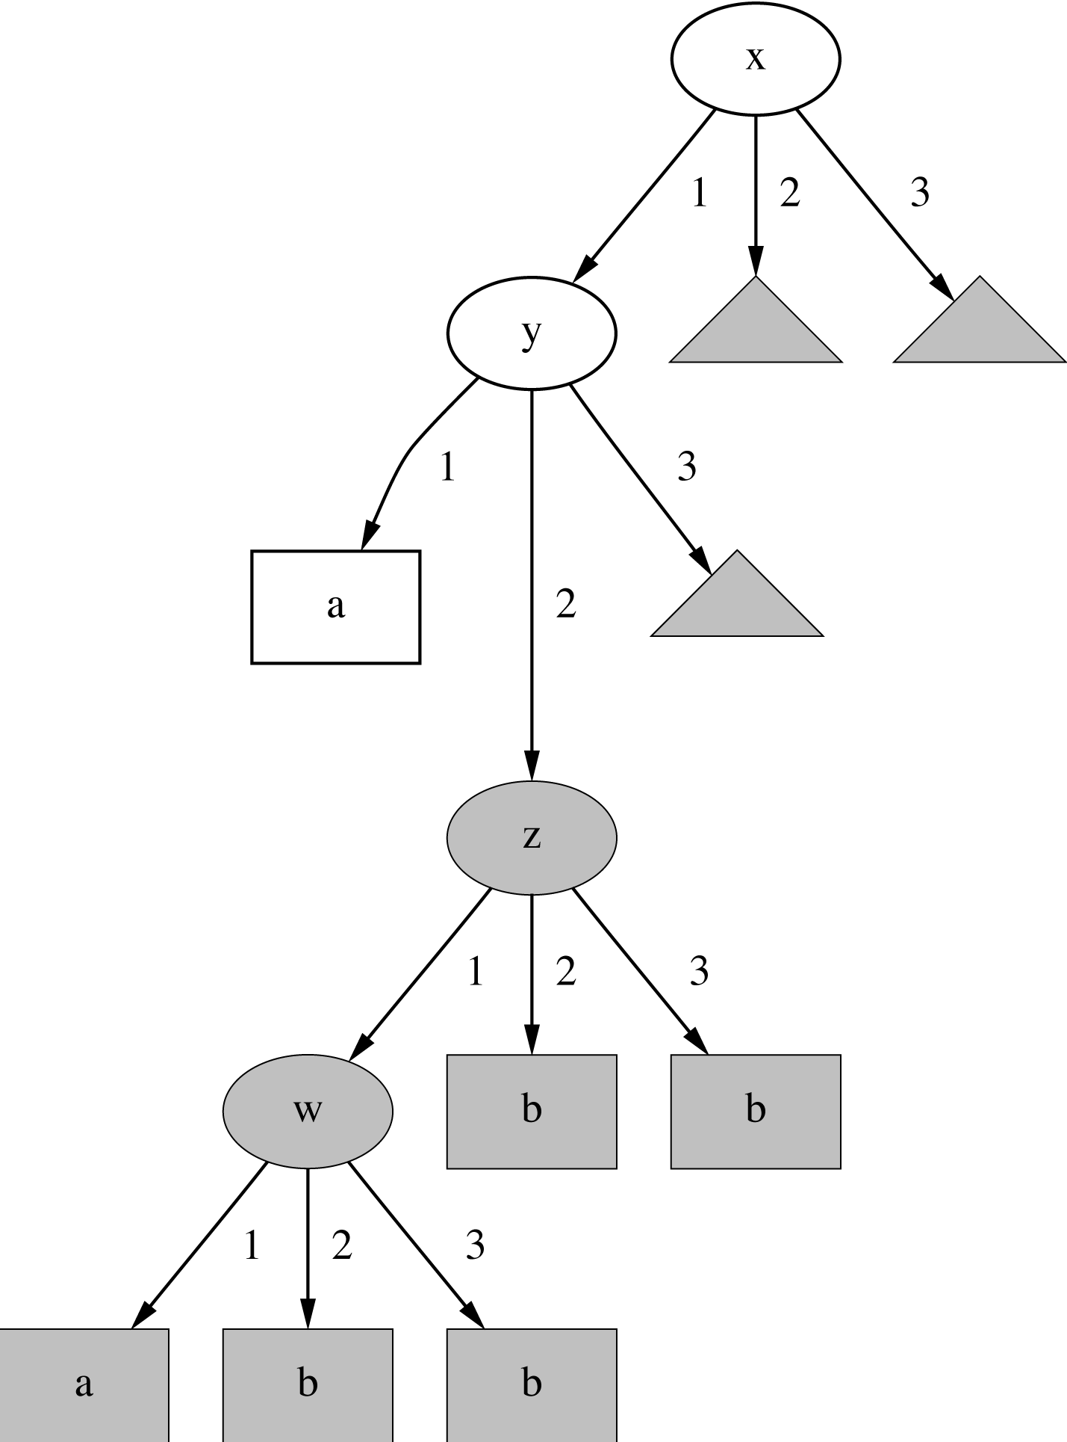
Another tree with a replicated subtree
If x = 1 and y = 1 then class = a
If z = 1 and w = 1 then class = a
Otherwise class = b
Notes:
Two very simple original rule, with a default “otherwise”
Suppose W, X, Y and Z can each have 3 values i.e. 1, 2 or 3
4 cases of the same subtree – the z subtree
The z subtree is needed if x =2 or x = 3 (i.e. not x=1) ; also if x = 1 and y = 2 or y = 3 (i.e. not y=1)
A decision tree has to replicate the whole z subtree 4 times - starting at the 3 triangles as well as the grey oval
If reading back from the tree - get very long complicated sequence of tests starting at the root
e.g. If x = 1 and y = 2 and z = 1 and w =2 then b

Slide 26
“Nuggets” of knowledge
Are rules independent pieces of knowledge?
It seems easy to add a rule to an existing rule base.
Problem: ignores how rules are executed
Two ways of executing a rule set:
Ordered set of rules (“decision list”)
Order is important for interpretation
Unordered set of rules
Rules may overlap and lead to different conclusions for the same instance

Slide 27
Interpreting rules
What if two or more rules conflict?
Give no conclusion at all?
Go with rule that is most popular on training data?
….
What if no rule applies to a test instance?
Give no conclusion at all?
Go with class that is most frequent in training data?
….
Notes:
Doesn’t happen with rules read off a decision tree, decision trees are “complete”

Slide 28
Special Case for Rules: Boolean Classification
Two classes “yes” and “no”
Assumption: if instance does not belong to class “yes”, it belongs to class “no”
Trick: only learn rules for class “yes” and use a default rule for “no”
Order of rules is not important. No conflicts!
Rule can be written in disjunctive normal form
If x = 1 and y = 1 then class = a
If z = 1 and w = 1 then class = a
Otherwise class = b

Slide 29
Association Rules
Association rules…
can predict any attribute
can predict combinations of attributes
are not intended to be used together as a set
Problem: immense number of possible associations
Which ones?
Show only the most predictive associations
high support and high confidence

Slide 30
Association rules
Outlook | Temperature | Humidity | Windy | Play
Sunny | Hot | high | false | no
Sunny | Hot | high | true | no
Overcast | Hot | high | false | yes
Rainy | Mild | high | false | yes
Rainy | Cool | normal | false | yes
Rainy | Cool | normal | true | no
Overcast | Cool | normal | true | yes
Sunny | Mild | high | false | no
Sunny | Cool | normal | false | yes
Rainy | Mild | normal | false | yes
Sunny | Mild | normal | true | yes
Overcast | Mild | high | true | yes
Overcast | Hot | normal | false | yes
Rainy | Mild | high | true | no
Example – weather data
4 Cool days with normal humidity; no cool days with any other humidity
Association rule:
If temperature = cool
then humidity = normal

Slide 31
Support and Confidence of Rules
Support: number of instances predicted correctly
Confidence: number of correct predictions, as a proportion of all instances that rule applies to
Example:
Support = 4
4 Cool days
Confidence = 100%
All Cool days have normal humidity
If temperature = cool then humidity = normal
Notes:
Rules may not be 100 per cent correct
Want rules that cover many instances – support
Also want them to mainly make correct predictions – confidence
E.g. at least two instances for any rule & rule should make 95% correct predictions

Slide 32
Support and Confidence of Rules
Normally: pre-specify minimum support and confidence
E.g. Support >= 2 and confidence >= 95%
Is this an acceptable rule?
Support =
Confidence =
58 rules with support >= 2 and confidence >= 95% for weather data!
If temperature = hot then humidity = high
Notes:
E.g. at least two instances for any rule (support) & rule should make 95% correct predictions (confidence)
Support = 4 (4 hot days)
Confidence = 75% (3 hot days have high humidity, one does not)

Slide 33
Meaning of Association Rules
Be careful – the logical meaning of association rules is complex
Does not mean:
Does mean:
If windy = false and play = no then outlook = sunny and humidity = high
If windy = false and play = no then outlook = sunny
If windy = false and play = no then humidity = high
If humidity = high and windy = false and play = no
then outlook = sunny

Slide 34
Rules with exceptions
Idea: allow rules to have exceptions
Example: rule for iris data
New instance:
Modified rule:
If petal-length ≥ 2.45 and petal-length < 4.45 then Iris-versicolor
Sepal
length
Sepal
width
Petal
length
Petal
width
Type
5.1
3.5
2.6
0.2
Iris-setosa
If petal-length ≥ 2.45 and petal-length < 4.45 then Iris-versicolor
EXCEPT if petal-width < 1.0 then Iris-setosa

Slide 35
Rules with exceptions
Can create rules with nested exceptions (exceptions to exceptions)
Logically equivalent to ordinary rules
Default … Except If … Then …
If .. Then .. Else …
Defaults are more common, exceptions are the special cases
Modular and incremental, useful for understanding large rule sets
Psychologically plausible
Notes:
Patient has a temperature – assume they have flu unless they also have spots, then they measles
Default patient has flu except that if they also have spots then they have measles
If patient has a spots then measles otherwise flu

Slide 36
Rules involving relations
So far: all rules involved comparing an attribute-value to a constant (e.g. temperature < 45)
These rules are called propositional because they have the same expressive power as propositional logic
What if problem involves relationships between instances?
E.g. family tree problem from earlier lecture
Could be denormalised
E.g. temperature today < temperature yesterday
Can’t be denormalized (in any obvious way)
What if problems involve relationships between attributes?
Can’t be expressed with propositional rules
More expressive representation required
Notes:
We discussed other problems with relationships between instances, eg. recursion

Slide 37
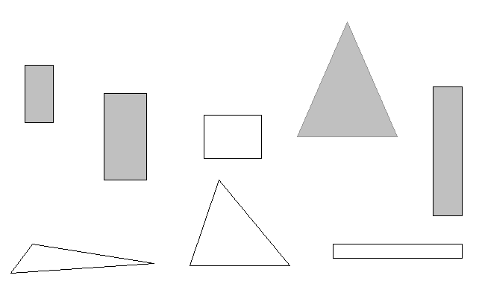
Complex reasoning: The shapes problem
Target concept: standing up
Shaded: standing Unshaded: lying

Slide 38
A propositional solution
Width
Height
Sides
Class
2
4
4
Standing
3
6
4
Standing
4
3
4
Lying
7
8
3
Standing
7
6
3
Lying
2
9
4
Standing
9
1
4
Lying
10
2
3
Lying
If width ≥ 3.5 and height < 7.0 then lying
If height ≥ 3.5 then standing
Notes:
Start from a table of width, height and number of sides
A propositional solution only contains attributes on one side of a comparison e.g. width > 3.5, height > 3.5
Could learn a lot of different rules like this
Maybe given enough examples could learn enough propositional rules to be reliable on new data? Is this possible?
These rules are very specific, don’t generalize
Really these rules are examples of one much more general rule

Slide 39
A relational solution
Comparing attributes with each other
Generalizes better to new data
Standard relations: =, <, >
But: learning relational rules is costly
Simple solution: add extra attributes (e.g. a binary attribute is width < height?)
If width > height then lying
If height > width then standing
Notes:
Relational solutions contain attributes on BOTH sides – e.g. width > height
What are the downsides of adding extra attributes?
Many attirbutes -> many relations
Not really discovering the relationship - more like testing it

Slide 40
More Complications
Using variables and multiple relations:
The top of a tower of blocks is standing:
The whole tower is standing:
Recursive definition!
If height_and_width_of(x,h,w) and h > w then standing(x)
If height_and_width_of(x,h,w) and h > w and is_top_of(y,x) then standing(x)
If is_top_of(x,z) and height_and_width_of(z,h,w) and h > w and is_rest_of(x,y)and standing(y) then standing(x)
If empty(x) then standing(x)
Notes:
Variables x, h, w with a relationship height-and-and-width
Beyond propositional logic and into predicates
Rule 1 If height > width then it’s a standing tower (equivalent to the rule on previous slide)
Rule 3 If z is the top of the tower and z is standing and y is the rest of x and y is standing
Then x is standing
Plus – an empty tower is standing
We keep applying the first bit until we get to an empty tower

Slide 41
“Inductive Logic Programming”
Relational and recursive rules
Open research topic
We’re not going there!
Notes:
You should be aware of the limitations of using propositonal rules and methods
But methods for learning more complex relationships are outside our scople

Slide 42
So that was rules…
So far
Linear models
Rules
Trees
What else can we learn?
Instance-based representations
Clusters

Slide 43
Instance-based representations
Rote learning – remember a similar instance
Look in the training set for instances that are most like the new example
Knowledge = instances + similarity function
Simple example: nearest neighbour
“Lazy” because we only do any work when a new instance comes along to be classified

Slide 44
Instance-based representations
Distance function
Simplest case: one numeric attribute
Distance is the difference between the two attribute values involved (or a function thereof)
Several numeric attributes:
normally, Euclidean distance is used and attributes are normalized
Nominal attributes:
distance is set to 1 if values are different, 0 if they are equal
Are all attributes equally important?
Weighting the attributes might be necessary

Slide 45
Instance-based representations
Nearest neighbour kNN – Weka IBk
Use one nearest neighbour (k=1) or several nearest neighbours
Classification or regression
Classification – same class as nearest neighbour, or largest vote if several neighbours
Regression – same value as nearest neighbour or mean if several neighbours
Nearest neighbour is sensitive to noisy data; more neighbours means less sensitivity to noise but more overlap / fuzziness
Unbalanced classes: majority voting means likely to get the most common class value; weight the values by distance

Slide 46
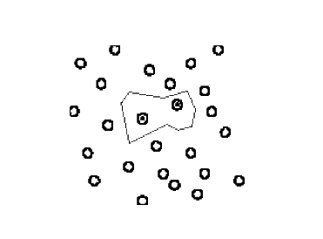
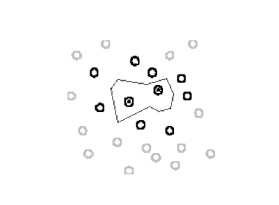
Learning prototypes
Only those instances involved in a decision need to be stored
Noisy instances should be filtered out
Idea: only use prototypical examples
Notes:
Don’t need to store all the instances - would make NN slow
If you have an area where all the instances have the same class donlt need many instances inside the area, just the boundaries, i.e. the instances that help you make a decision
Do instance-based methods create a representation of what’s been learned? Yes, they create boundaries (lines or planes or hyperplanes) wich split the instances up between

Slide 47
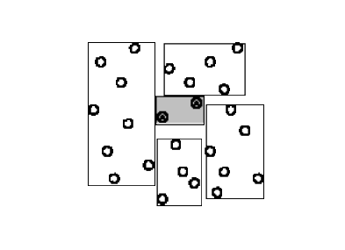
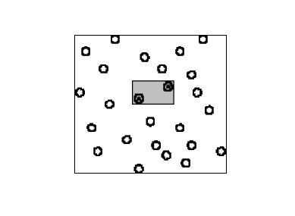
Rectangular generalizations
1.
2.
1. Nearest-neighbor rule is used outside the rectangles
Rectangles are rules! (But they can be more conservative than “normal” rules.)
2. Nested rectangles are rules with exceptions
Notes:
Take things a step further – generalise to create rectangular areas and say everything in the area belongs to one class or the other
Becomes a bit like rules – special rules that test against upper and lower bounds and select the region in between; each dimension is an attribute and the attributes are ANDED together
No overlap = just 1 rule applies
Close fitting rectangles make conservative rules (i.e. rules that cover a small area and only have a single class inside, no overlaps between classes) because you can still use NN outside the rectangles (unlike ordinary rules)
Second picture shows NESTED recotangles – i.e. rules with exceptions

Slide 48
Clusters
Identify clusters of similar data
Unsupervised method
Simple: Label each instance with the cluster it belongs to

Slide 49
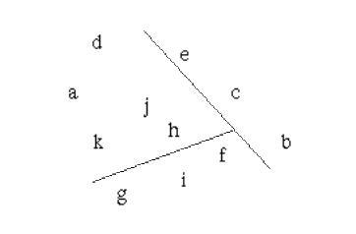
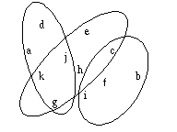
Representing clusters I
Simple 2-D representation
Venn diagram
Overlapping clusters
Notes:
Distinct areas
Overlapping

Slide 50
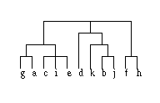
Representing clusters II
Probabilistic assignment
Dendrogram
1 2 3
a 0.4 0.1 0.5
b 0.1 0.8 0.1
c 0.3 0.3 0.4
d 0.1 0.1 0.8
e 0.4 0.2 0.4
f 0.1 0.4 0.5
g 0.7 0.2 0.1
h 0.5 0.4 0.1
…
NB: dendron is the Greek word for tree
Notes:
Probabilistic
Hieirarchical

Slide 51
Knowledge Representation
Chapter 3 “Data Mining” Witten Frank & Hall
Next lecture:
Statistics
Coursework 1

